Slide 1
WHY
THIS
CLASS ?

Slide 2
Does this code produce an error ?
let user = "name";
user = 4;
console.log(user);

Slide 3
Does this code produce an error ?
NO !!
let user = "name";
user = 4;
console.log(user);
user should still be a string, not an integer !
It’s difficult to find errors with JavaScript

Slide 4
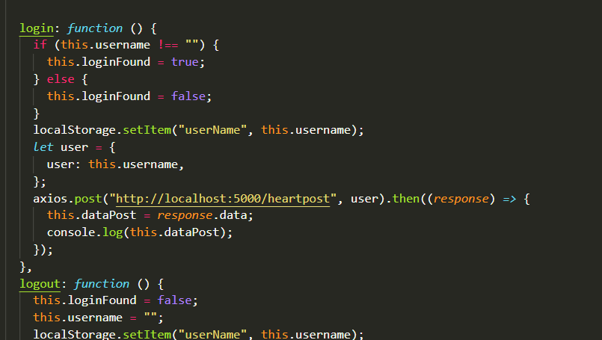
Can you identity easy
the type of dataPost?

Slide 5
Can you identity easy
the type of dataPost?
NO !!

Slide 6
1
It’s hard to code fast in JavaScript
Because JavaScript in an untyped language
untyped = no type declaration

Slide 7

In real life, we talk about trees, table, pianos
Not array of strings or dictionaries

Slide 8
2
Write code with real things
We would like to define structures to represent the world
A person is composed of a name, a age....

Slide 9
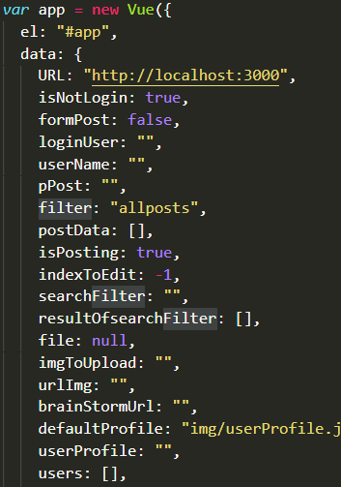
How do we manage
Large programs
with a lot of data to manipulate ?

Slide 10

How to avoid spaghetti code ?

Slide 11
In Object-Oriented-Programming:
We group things in logical units (objects)
data
actions
on data

Slide 12
1
Typed languages
OOP
7
Polymorphism
2
Object/Class
6
Inheritance
3
Aggregation
5
Objects references
4
Encapsulation

Slide 13
Course evaluation
MAR
CHAPTER 1 - Typed languages
CHAPTER 2 - Object/Class
QUIZ 1 - 5 %
CHAPTER 3 - Aggregation
CHAPTER 4 - Encapsulation
QUIZ 2 - 5 %
CHAPTER 5 - Objects references
APR
CHAPTER 6 Inheritance
QUIZ 3 - 10 %
CHAPTER 6 Polymorphism
PROJECT
PROJECT - 30 %
MAY
EXAM
FINAL - 50 %

Slide 14
1
Typed languages
OOP
7
Polymorphism
2
Object/Class
6
Inheritance
3
Aggregation
5
Objects references
4
Encapsulation

Slide 15
OOP - CHAPTER 1
TYPED LANGUAGES
PREVENT ERRORS WITH TYPES

Slide 16

From JavaScript to TypeScript
1995 : JavaScript
2012: TypeScript
Notes:
Invented in 1995, JavaScript was designed as a small scripting language for simple web pages in browsers. It wasn’t until 1999 that JavaScript was capable of supporting the kinds of dynamic web pages we see today, and using JavaScript that way wasn’t common practice until 2005.
To serve its original use-case, JavaScript was designed to be very flexible and easy to use for small applications. These features make JavaScript a great first language to learn, but they also make it less-than-ideal for building larger-scale applications with hundreds or even thousands of files. Stricter programming languages will inform the developer when they change one area of code in a way that will break other areas. JavaScript will not, which often leads to unexpected behavior at runtime.
To address these shortcomings, Microsoft developed TypeScript and released publicly in 2012 to blend the flexibility of JavaScript with the advantages of a stricter language.

Slide 17

INSTALLATION
On VSCode, open a terminal and perform those 4 steps :
1 - Add NPM to the PATH
setx PATH "%PATH%;C:\Users\pros.nob\AppData\Roaming\npm;"
2 – Install Typescript globally
Your window account !!
npm install -g typescript
3 - Allow scripts to execute
Set-ExecutionPolicy -Scope CurrentUser Unrestricted
4 – DONE !! Just check TypeScript works :
tsc --version

Slide 18
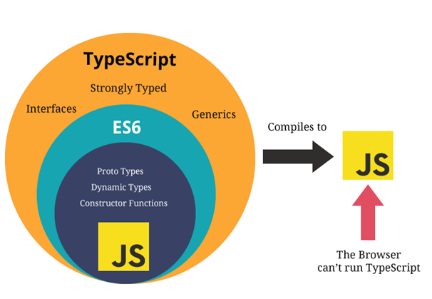
What is Typescript ?
Objects
tsc

Slide 19
What is Typescript ?
1- You can write JavaScript in Typescript !
2- You need to compile your Typescript!
A compiler is a small program
To transform a language into
Another language
TS
JS

Slide 20
RULE 1- Typescript can guess your type
let user = "ronan";
user = 45;
console.log(user);
Typescript detects a type script
Typescript detects an error :
Cannot assign a integer to a string

Slide 21
RULE 2- If Typescript cannot guess, the type is : any
let user;
Typescript does not detect anything, type is any

Slide 22
RULE 3 - Variables can have annotations after their names
let mustBeAString : string;
TYPE

Slide 23
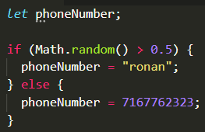
ACTIVITY
1- Open activity3.ts
2- Add an annotation to type phone Number
String or number !
3- Check now, you have a mistake
And fix it !

Slide 24
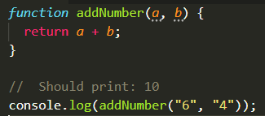
ACTIVITY
1- Open activity4.ts
2- Compile : tsc activity4.ts
3- Run : node activity4.js
Check the result is not correct !
4- To fix this : add some type to the parameter a and b, to specify you want 2 numbers
5 – Fix the problem then with the “6” and “4”

Slide 25
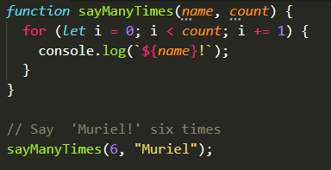
ACTIVITY
1- Open activity5.ts
2- Compile : tsc activity5.ts
3- Run : node activity5.js
Check the result is not correct !
4- To fix this : add some type to parameters name and count in the function
5 – Then fix the problem in the function call : sayManyTimes(6, "Muriel");

Slide 26
RULE 4- You can choose if parameter are: mandatory or optional
function printInfo (name: string, age: number) {
console.log("name is " + name + " age is " + age );
}
printInformation("ronan");
MANDATORY
ERROR : because age is not provided
function printInfo (name: string, age?: number) {
console.log("name is " + name + " age is " + age );
}
printInformation("ronan");
OPTIONAL
NO ERROR because age is optional

Slide 27
RULE 5- Inference of types: TypeScript can guess types
1
let user = "ronan";
let n = user.lastIndexOf("r")
print(n)
User is a String
2
lastIndexOF
String --🡪 number
3
So n is a number

Slide 28
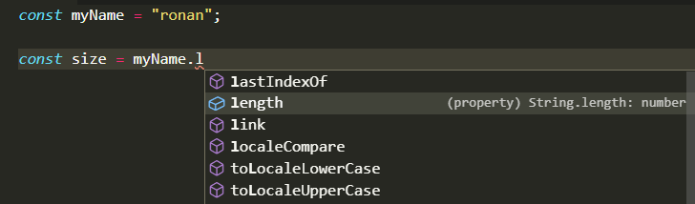

Type code to make the edition easier
myName is a string
So while editing code, Typescript will display the properties /functions related to string only

Slide 29
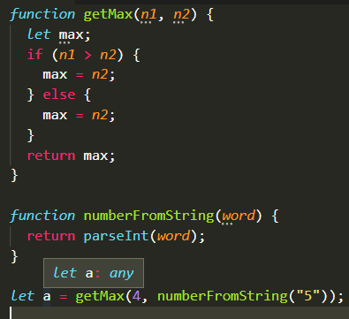
ACTIVITY
1- Open activity6.ts
2- Right now the type of “a” is any
Because no types are specified in the code
3- Improve this : add types to parameters, function return, variables ….
4– Then check that the display type (when mouse hover) of a is : number

Slide 30

TYPE
SYNTAX !

Slide 31
1- PRIMITIVE TYPES !
let name : string = "ronan";
A string
2 ARRAY TYPES !
let nums : number[] = [5, 8];
An array of numbers

Slide 32
3- UNION OF TYPES !
let name : string |boolean = "ronan";
Can be a string or a boolean
let nums : (number|string)[] = [5, " 8 "];
An array of number or strings

Slide 33
4- OBJECT TYPES !
let student : { x: number; y: number } = {x : 45, y : 55};
An object composed of 2 numbers
let students : { x: number; y: number }[] = [
{x : 45, y : 55},
{x : 99, y : 77}
]
An array of object composed of 2 numbers

Slide 34
5- ALIAS TYPES !
We want to use the same type more than once and refer to it by a single name.
BEFORE
AFTER
let sun: { name: string; age : number }
= { name: ‘vun’, age: 17 }
let som: { name: string; age : number }
= { name: ‘som’, age: 48 }
type Student = { name: string; age : number }
let sun:Student= { name: ‘vun’, age: 17 }
let som:Student= { name: ‘som’, age: 48 }

Slide 35
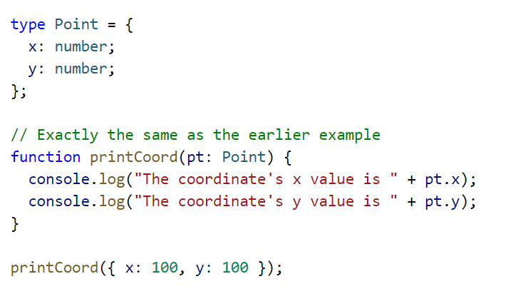
Example :
create an alias to define a Point (x, y)

Slide 36
Does this code produce an error ?
let student : { age: number; address: string} =
{ age : 19,
address : 45
};
A - YES
B - NO

Slide 37
Does this code produce an error ?
let nums : (number|boolean) [] = [5, false, 58];
A - YES
B - NO

Slide 38
Does this code produce an error ?
let nums : (number|boolean) [] = [5, false, " 58 "];
A - YES
B - NO

Slide 39
Does this code produce an error ?
let students : { age: number; address: string} [] =
[ { age : 19, address : “paris “},
{ age : 15, address : “chicago “},
];
A - YES
B - NO

Slide 40
Does this code produce an error ?
Type Result= {
topic: string;
score: number;
student: string;
}
Let ronanResult : Result = {topic: ‘java’, score:45 }
A - YES
B - NO

Slide 41

TO SUM UP
On this course we will improve your code style :
Type data to avoid mistakes
Group data into objects to avoid spaghetti code
RULE 1 - Typescript can guess the type of your variable
RULE 2 – If no type, the type is: any
RULE 3 – You can specify the type using annotation age : number
RULE 4 – You can decide a parameter is optional function test(name ? : string)
RULE 5 – Inference of types : Typescript can guess type even of multiple function calls

Slide 42

WANT TO GO FURTHER ?
BASICS TO START TYPESCRIPT
https://www.typescriptlang.org/docs/handbook/2/basic-types.html

